Slide 1
Crude Unit Metal Dusting
Elyssa Zhang Okkelberg
Materials, Corrosion, and Welding Engineer
NACE 2021
STG 34/TEG 205X Information Exchange

Slide 2
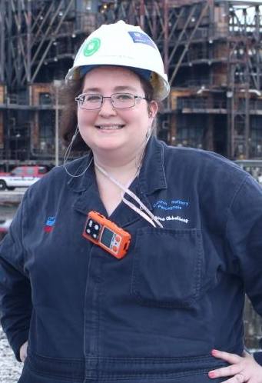
Presenter
Materials, Corrosion, and Welding Engineer, Pasadena Refinery, TX
Sole Plant Support including Crude, Szorb, FCC, HF Alky, Reformer, DHT, etc.
Educational Background
M.S. Welding Engineering, Ohio State
B.Sc.in Materials Science Engineering, Penn State
B.A. Art History, Penn State
Minor Nanotechnology, Penn State
Professional Experience
10 years at 3 Refinery and Petrochemical Sites
Ely Okkelberg

Slide 3
Metal Dusting Process Conditions
Corrosion mechanism background and case studies can be found in 2001 NACE Paper 01378
Metallurgy: 5Chrome
Temperature: 1150F via IR Scans
Sulfur: 3000 ppm (0.3% weight)
TAN: < 0.5 mgKOH/ml
Corrosion Rates: Up to 888mpy
Mechanism: Excessive thinning due to carburization and metal dusting
6pm

Slide 4
6pm
Notes:
0.03” near area of interest

Slide 7
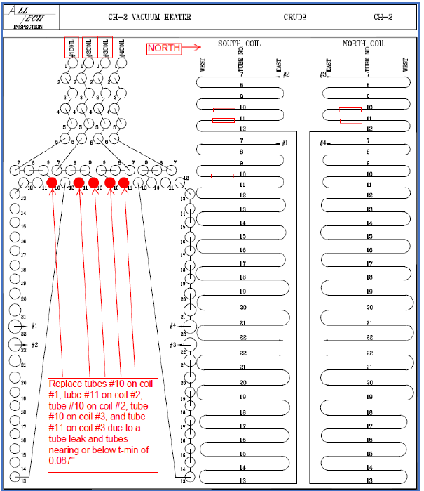

Slide 8
Notes:
38 days between UT readings

Slide 9
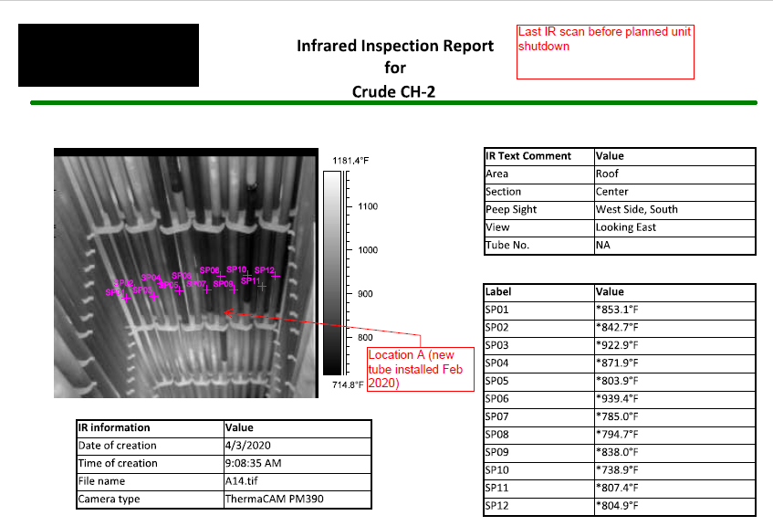

Slide 10
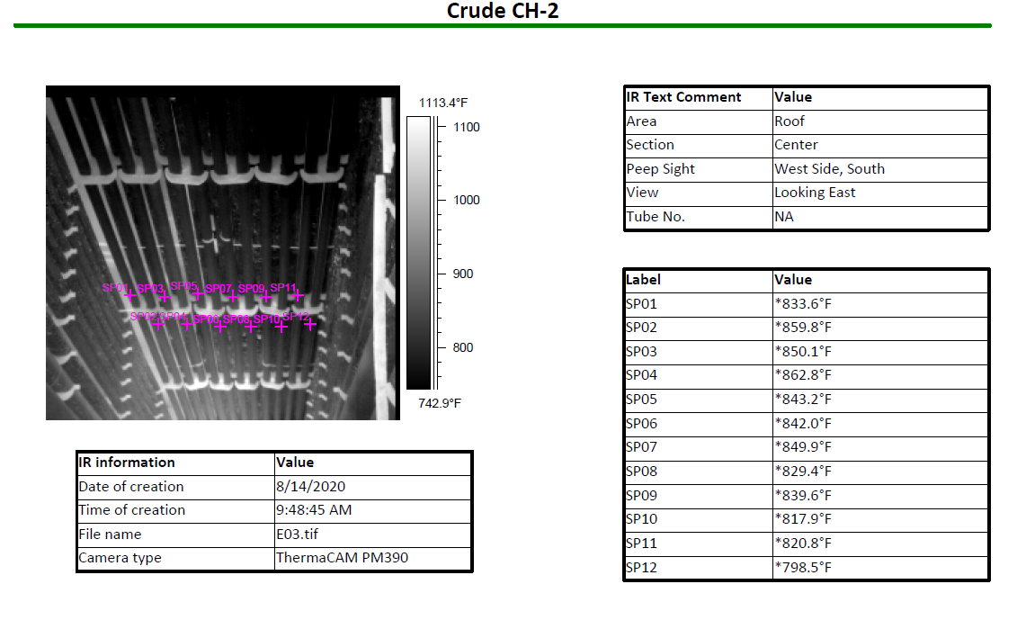

Slide 11
Thank you! Any Questions?
Contact for any follow-up discussions or any sharing of other similar case studies
ELYO@chevron.com
Acknowledgment
Davis Cooke, Al Hegger, Tommy Thompson, Carol-Ann Laughlin, and Dave Cooke
Notes:
Failure Analysis Report, Images, Consultation, and Reviews

