Slide 1
Recycle Hydrogen Piping Failure
Joe Koerner
This information is provided herein is for general informational purposes only. This presentation addresses statements, discussions, opinions and suggestions that may not apply or may be different depending on the particular situation. When engaged in addressing any of the issues discussed herein, you should consult an expert in this area before proceeding so that your exact issue is addressed properly. The presenter on behalf of himself and Flint Hills Resources, LLC and its affiliates (“FHR”) hereby disclaims any liability whatsoever for the information contained in, and presented with, this presentation. FHR does not guarantee the accuracy of the data included in this paper and accepts no responsibility for any consequences of their use.

Slide 2
Distillate Hydrotreater Recycle H2
Outlet piping from hydrogen only heater
Constructed of 347SS, 1992 vintage
4 NPS, sch 80 (0.337 in) & 12 NPS, sch 100 (0.844 in)
Long seams were solution annealed per A312
All other welds (circs, o-lets, etc.) were not PWHT’d
Hot recycle H2 mixes with preheated hydrocarbon feed upstream of reactor
Hydrogen at 650-950°F – used to control reactor inlet temperature

Slide 3
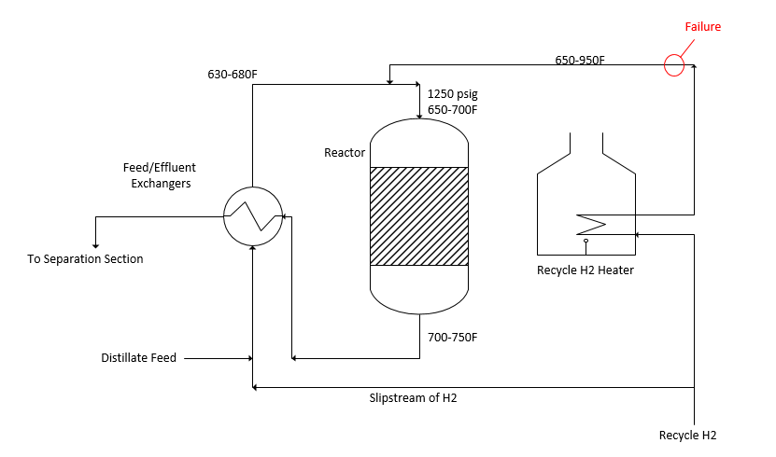

Slide 4
Failure
Small leak observed near elbow on piping expansion loop; controlled unit shutdown; no injuries or secondary damage
Inspection found through wall crack at 12 NPS (0.84” wall) elbow-to-pipe butt weld
Weld cut out for metallography
Cracking was from ID to OD
Cracking was intergranular and traveled in HAZ and WM
HAZ was highly sensitized; BM away from weld not sensitized
Hardness of BM, HAZ, WM: 200-300 HV
Grain size 3-7

Slide 5
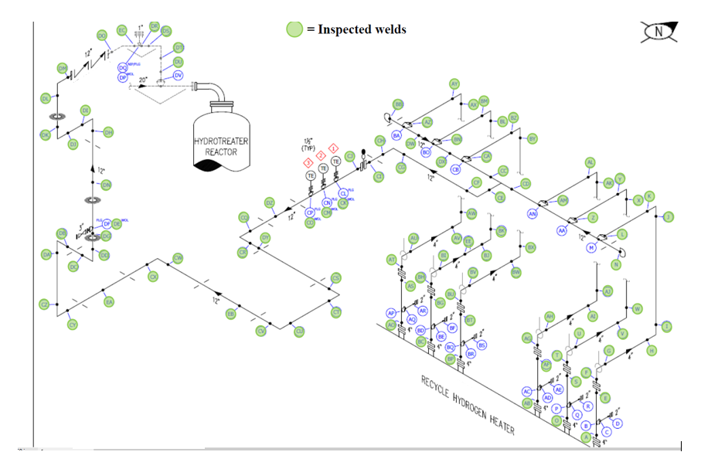
Leak Location
Failure

Slide 6
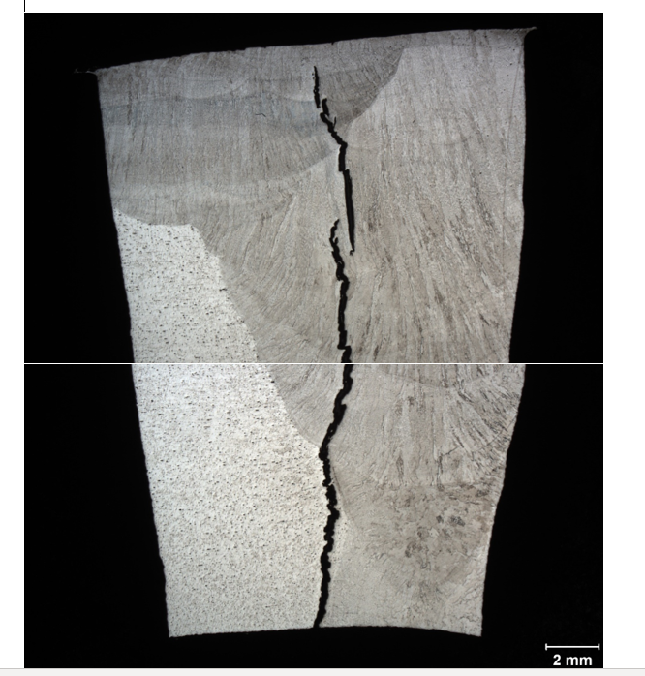
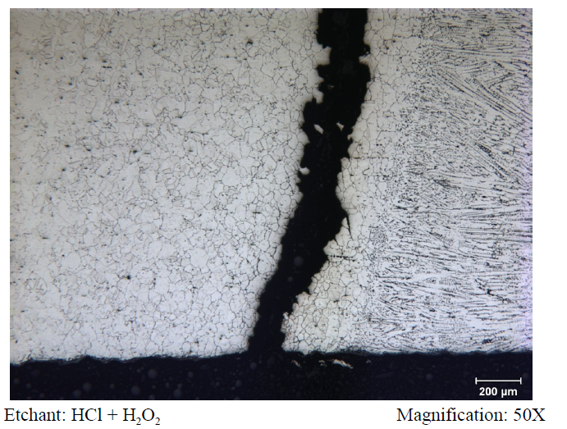

Slide 7
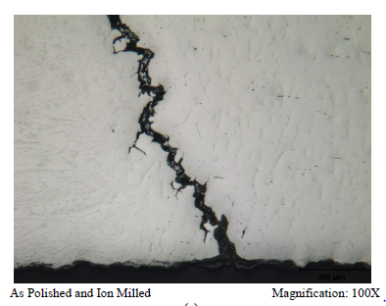
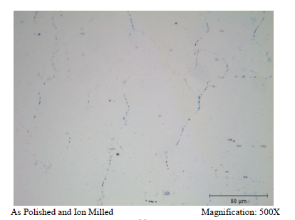
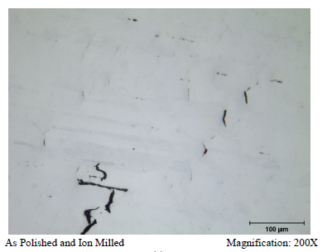
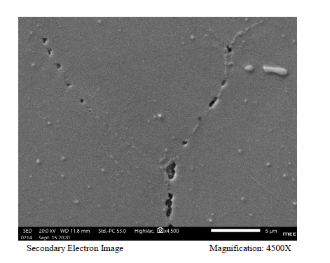

Slide 8
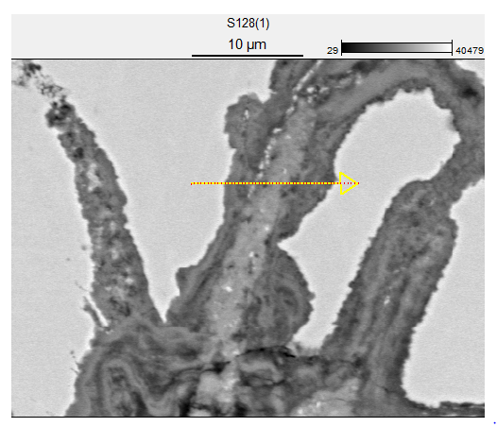
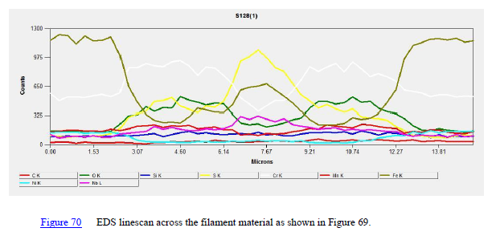

Slide 9
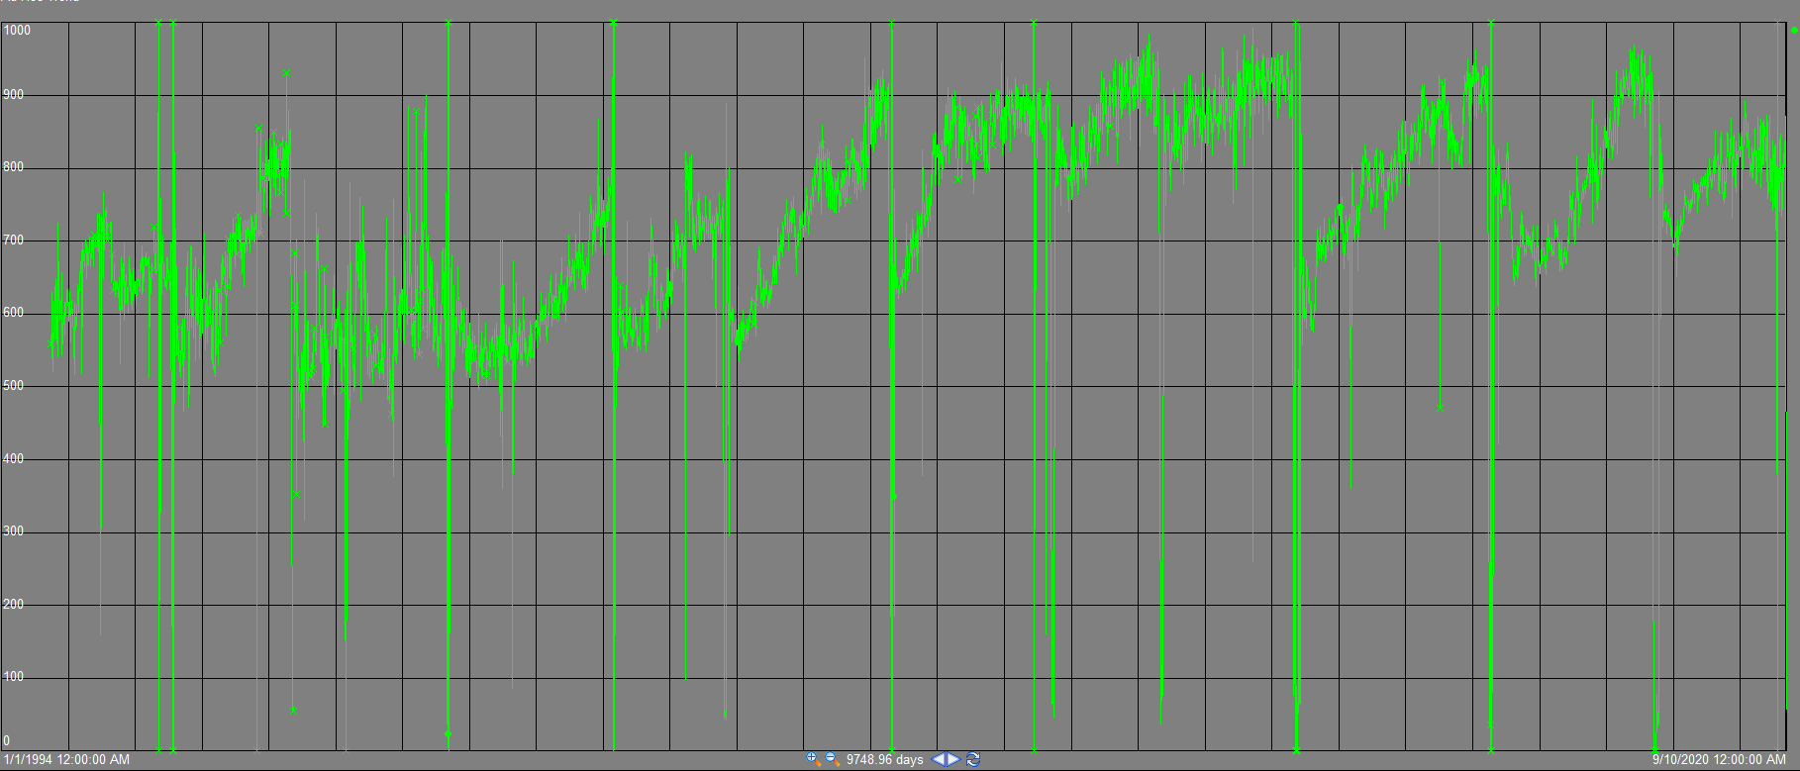
Heater Outlet Temperature
Increasing in 2006 due to ULSD requirements
Didn’t run sustained temps over 900F until 2010

Slide 10
Inspection
PAUT of all welds on heater outlet piping
Found 13 others with crack like indications – all were in 12 NPS or larger piping, most at a fitting-to-pipe weld
No crack indications found in 4 NPS pipe
PAUT of some welds in hydrocarbon piping from F/E exchangers and reactor outlet piping
No crack indications found

Slide 11
Conclusions
Stress Relaxation Cracking most likely mechanism
Operation over 930°F for ~ 7500 hours (45 weeks)
Hardness >200 HV
Pipe thickness >1/2 in has higher restraint, no PWHT
Intergranular cracking
Numerous cavities on grain boundaries near the cracks
Morphology of cracking doesn’t look like Cl⁻ or PTA SCC
Minimal branching
Unusual for PTA SCC to go through weld metal

Slide 12
Repair
Ground out all crack-like indications
Some fittings replaced
Old piping was subjected to 1800°F low temperature anneal for 4 hrs
Repair welds then had a 1650°F PWHT for 1.5 hrs as recommended in API 942-B
Planned piping replacement in 2021 - 347SS with PWHT and IOW at 900°F

Slide 13
Key Learnings
CCD did not capture SRC as potential DM because average operating temperature was used (814°F)
SOR & EOR conditions especially important to characterize hydrotreater operation
Need to consider operating limits as range of unit operation
Need IOW’s to prevent drift into area with new DM’s
Discovered that our past PTA SCC mitigation wasn’t as good as we thought
Look back at PI at top of reactor suggests we may not have always had positive N2 pressure (operations monitor local gauge at grade)
Opportunity to use wireless pressure transmitters for constant monitoring

Slide 14
Thank You Questions?

